Slide 1
Haversham cum Little Linford Neighbourhood Plan
Open Meeting Presentation
Wednesday 14 March 2018

Slide 2

Tonight’s Agenda
What is a Neighbourhood Plan?
Existing MK Policies
What do we have to consider?
What opportunities do we have?
What is most important to us?

Slide 3
Making a
Neighbourhood Plan
What is a Neighbourhood Plan?
What can it influence and what is out of scope?
What do we want to achieve by making one?
What could happen if we don’t?

Slide 4
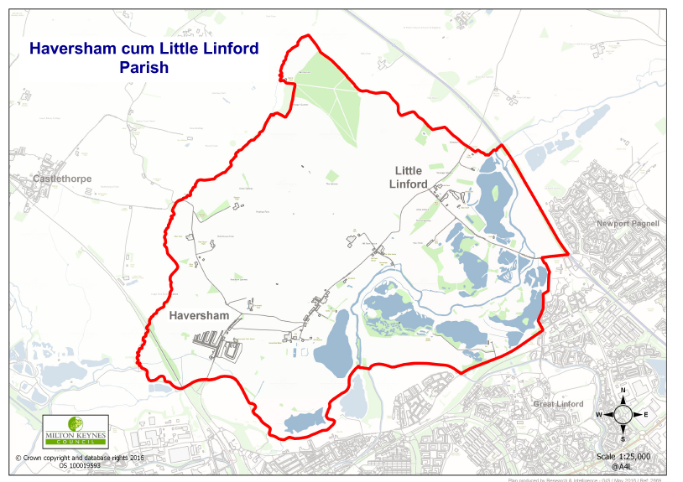

Slide 5
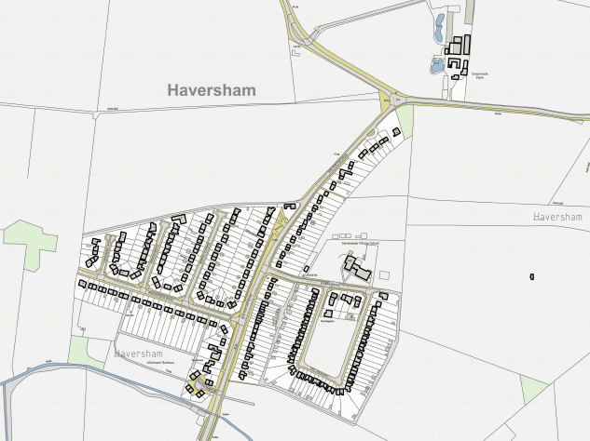

Slide 6
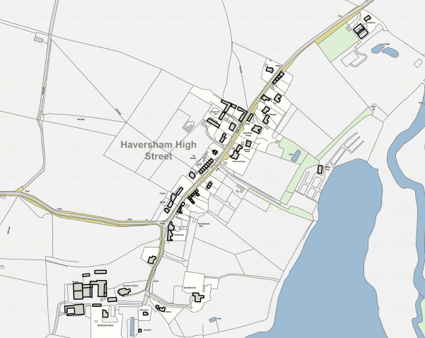

Slide 7
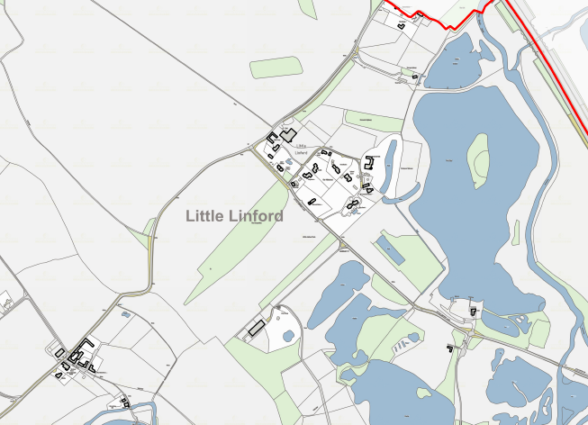

Slide 8
Existing MKC Policies
Defined development boundary at new village but old village and Little Linford part of the open countryside
Area of Attractive Landscape
Listed Buildings and Scheduled Ancient Monument
Linford Lakes Area/Linear Park
Open spaces and community facility (school) at new village

Slide 9
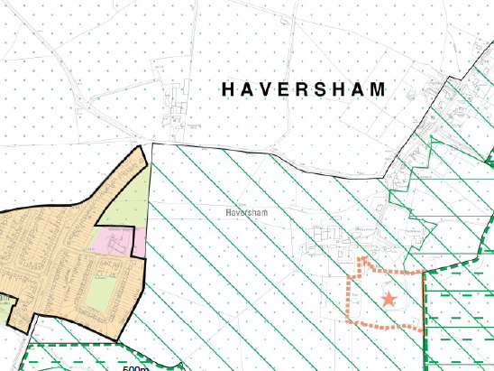

Slide 10
Considerations
rural location
few local services
landscape character
local nature reserve
through traffic
natural barrier of River Ouse

Slide 11
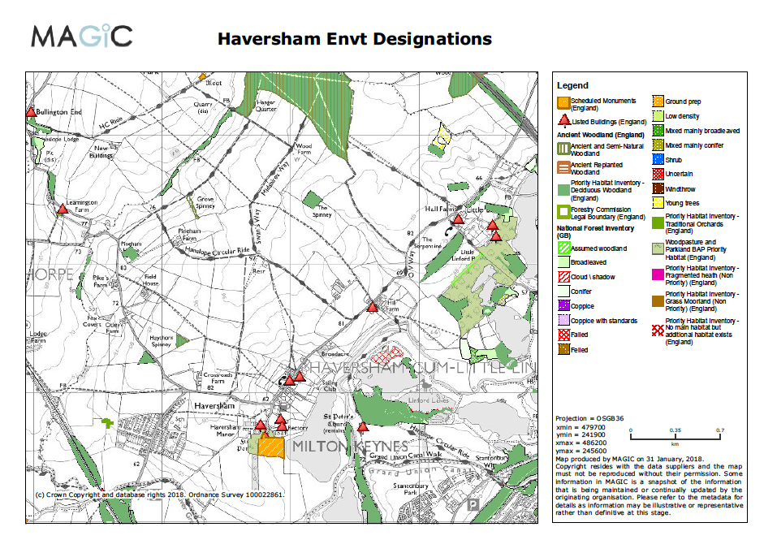

Slide 12
Opportunities
new homes to meet local needs
new community facility
investment in traffic management
relationship between old and new villages
high quality design
protection of rural part of Parish

Slide 13
Typical Objectives
manage traffic
preserve heritage
protect sensitive landscapes
avoid harm to biodiversity
protect characteristics of current settlement(s)
preserve or enhance community facilities

Slide 14
Traffic
How important is it that any new development avoids making existing traffic problems worse?
Are traffic management measures necessary and possible?

Slide 15
Heritage
How important is it that any new development avoids harming our listed buildings and other heritage assets?
Is there derelict/unkempt land that could be improved by new development?

Slide 16
Landscape
How important is it that any new development avoids the most sensitive landscape areas?

Slide 17
Biodiversity
How important is it that any new development avoids areas of biodiversity interest?

Slide 18
Settlement characteristics
How important is it to preserve the individual characteristics of the settlements in the parish?

Slide 19
Community Facility
How important is it that we have a new facility?
What factors should determine the best location for it?
How important is it going to be to use development funding (S106) to pay for any new facility?

Slide 20
Ranking Objectives
?
?
?
?
?
?

Slide 21
Conclusions?
What have we learned about what our Plan could do?
What level of consensus is there for the ranked objectives?

Slide 22
Next Steps
Questionnaire to everyone in Parish
Parish Council NP committee will evaluate:
  Outcome of tonight’s meeting
  Information from Questionnaires
  Options available
Draft Neighbourhood Plan produced for consultation
Submit Plan to MKC for examination then Referendum

Slide 23
Any Questions?

